Slide 1

Spring Framework

Slide 2
Spring introduction
Course overview:
  Spring framework overview
  Architecture, IoC, AOP
  XML Based Configuration and Annotation Based Configuration
  Bean Definition, Bean Scopes, Bean Life Cycle, Bean Post Processors, Bean Definition Inheritance
  Dependency Injection, Injecting Inner Beans, Injecting Collection, Beans Auto-Wiring
  Event Handling, Custom Events
  JdbcTemplate, DataSource, Transaction Management
  JPA, DAO, JpaTemplate

Slide 3
Spring introduction
Course overview:
  Pattern MVC
  Developing and Configuring the Views and the Controller
  Integrating the Web Application with the Persistence Layer
  Manage errors and exceptions with Spring MVC
  Spring MVC and Ajax
  REST/JSon Controller Management
  JUnit and Test

Slide 4
Spring introduction
Goal:
  Philosophy at the base of the Spring framework
  Using pattern dependency injection in a software architecture
  Implementing Java Web Applications with the Spring Framework
  Knowledge and Use of Aspect Oriented Programming
  JPA and Spring-based data access techniques
  Managing Transactions with Spring
  Managing REST/JSON with Spring

Slide 5

Spring introduction
Spring home:
https://spring.io/projects/spring-framework

Slide 6
Spring introduction
What is Spring?
The Spring Framework provides a comprehensive programming and configuration model for modern Java-based enterprise applications - on any kind of deployment platform.
A key element of Spring is infrastructural support at the application level.

Slide 7
Spring introduction
Key features:
  Core technologies: dependency injection, events, resources, validation, data binding, type conversion, AOP…
  Testing: mock objects, TestContext framework, Spring MVC Test…
  Data Access: transactions, DAO support, JDBC, ORM, Marshalling XML
  Spring MVC and Spring WebFlux web frameworks
  Integration: remoting, JMS, JCA, JMX, email, tasks, scheduling, cache.
  Languages: Kotlin, Groovy, dynamic languages.

Slide 8
Spring introduction
Minimum requirements:
  JDK 8+ for Spring Framework 5.x
  JDK 6+ for Spring Framework 4.x
  JDK 5+ for Spring Framework 3.x

Slide 9
Spring introduction
Spring does a lot of things
It is a system of organizing Java code, using either XML files, or, alternatively annotations.
But when you break it down to its core parts, Spring’s primary features are:
  dependency injection (DI) and
  aspect-oriented programming (AOP)

Slide 10
Spring introduction
Building Java Enterprise application is not a new concept – it dates back to 1998, with the specification of Java components to the server side
Despite the fact that many successful applications have been built based on Enterprise JavaBeans (EJB), EJB never achieved its intended purpose:
  to simplify enterprise application development
  As a result, its popularity has waned in recent years, leaving many developers looking for an easier way
Today, Java component development has returned to its roots

Slide 11
Spring introduction
New programming techniques, including aspect-oriented programming (AOP) and dependency injection (DI), are giving JavaBeans much of the power previously reserved for EJBs.
These techniques furnish plain-old Java objects (POJOs) with a declarative programming model reminiscent of EJB, but without all of EJB’s complexity.
Leading the charge for lightweight POJO-based development is the Spring Framework

Slide 12
Simplifying Java development
Spring is an open source framework
Spring was created to address the complexity of enterprise application development
Spring’s usefulness isn’t limited to server-side development:
  Any Java application can benefit from Spring in terms of simplicity, testability, and loose coupling

Slide 13
Simplifying Java development
Spring does many things. But at the root of almost everything Spring provides are a few foundational ideas, all focused on Spring’s fundamental mission: Spring simplifies Java development
To back up its attack on Java complexity, Spring employs four key strategies
Almost everything Spring does can be traced back to one or more of these four strategies

Slide 14
Key Strategies
Lightweight and minimally invasive development with plain old Java objects (POJOs)
Loose coupling through dependency injection and interface orientation
Declarative programming through aspects and common conventions
Boilerplate reduction through aspects and templates

Slide 15
Spring
A lightweight non-intrusive framework which addresses various tiers in a J2EE application.
  Presentation layer: Integrates with Struts to initialize action classes
  Business layer: Lightweight IoC container with support for AOP-driven interceptors and transaction.
  Persistence layer – DAO template support for Hibernate, SQLMaps and JDBC
  Factory implementation to abstract and integrate various other facets of enterprise applications like E-mails, JMS, WebServices, etc.
Helps integrates tiers together using XML configuration instead of hard-coding.
Substantially reduces code, speeds up development, facilitates easy testing and improves code quality.

Slide 16
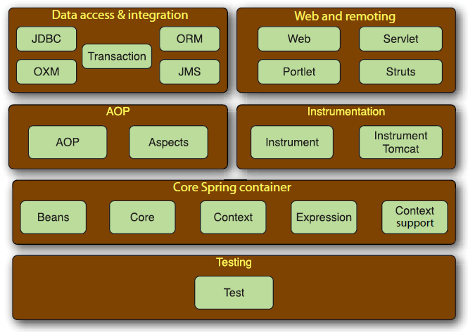
Spring Framework

Slide 17
Spring Framework
The Spring Framework is composed of several distinct modules.
When taken as a whole, these modules give you everything you need to develop enterprise-ready applications.
But you don’t have to base your application fully on the Spring Framework.
You’re free to choose the modules that suit your application

Slide 18
Core Spring Container
The centerpiece of the Spring Framework is a container that manages how the beans in a Spring-enabled application are created, configured, and managed
Within this module you’ll find the Spring bean factory, which is the portion of Spring that provides dependency injection
Building upon the bean factory, you’ll find several implementations of Spring’s application context, each of which provides a different way to configure Spring
This module also supplies many enterprise services such as email, JNDI access, EJB integration, and scheduling

Slide 19
AOP module
Spring provides rich support for aspect-oriented programming in its AOP module.
This module serves as the basis for developing your own aspects for your Spring-enabled application.
Like DI, AOP supports loose coupling of application objects.
But with AOP, application-wide concerns (such as transactions and security) are decoupled from the objects to which they’re applied

Slide 20
Data access and integration
Working with JDBC often results in a lot of boilerplate code that gets a connection, creates a statement, processes a result set, and then closes the connection
Spring’s JDBC and data access objects (DAO) module abstracts away the boilerplate code so that you can keep your database code clean and simple, and prevents problems that result from a failure to close database resources
This module also builds a layer of meaningful exceptions on top of the error messages given by several database servers - No more trying to decipher cryptic and proprietary SQL error messages!

Slide 21
Data access and integration
For those who prefer using an object-relational mapping (ORM) tool over straight JDBC, Spring provides the ORM module.
Spring’s ORM support builds on the DAO support, providing a convenient way to build DAOs for several ORM solutions.
Spring doesn’t attempt to implement its own ORM solution, but does provide hooks into several popular ORM frameworks, including Hibernate, Java Persistence API, Java Data Objects, and iBATIS SQL Maps.
Spring’s transaction management supports each of these ORM frameworks as well as JDBC.

Slide 22
Web and remote
The Model-View-Controller (MVC) paradigm is a commonly accepted approach to building web applications such that the user interface is separate from the application logic
Even though Spring integrates with several popular MVC frameworks, its web and remoting module comes with a capable MVC framework that promotes Spring’s loosely coupled techniques in the web layer of an application.
Java has no shortage of MVC frameworks, with Apache Struts, JSF, WebWork…
This module also provides several remoting options for building applications that interact with other applications

Slide 23
Testing
Recognizing the importance of developer-written tests, Spring provides a module dedicated to testing Spring applications
Within this module you’ll find a collection of mock object implementations for writing unit tests against code that works with JNDI, servlets, and portlets.
For integration-level testing, this module provides support for loading a collection of beans in a Spring application context and working with the beans in that context

Slide 24
Spring benefits
Not a J2EE container. Doesn’t compete with J2EE app servers. Simply provides alternatives.
POJO-based, non-invasive framework which allows a la carte usage of its components.
Promotes decoupling and reusability
Reduces coding effort and enforces design discipline by providing out-of-box implicit pattern implementations such as singleton, factory, service locator etc.
Removes common code issues like leaking connections and more
Support for declarative transaction management
Easy integration with third party tools and technologies.

Slide 25
Dependency injection
The phrase dependency injection may sound intimidating, implying use of a complex programming technique or design pattern
However, it is not nearly as complex as it sounds
Applying DI in your project will lead to code which is significantly simpler, easier to understand and easier to test code

Slide 26
Dependency injection
Any nontrivial application (pretty much anything more complex than a Hello World example) is made up of two or more classes that collaborate with each other to perform some business logic.
Traditionally, each object is responsible for obtaining its own references to the objects it collaborates with (its dependencies).
This can lead to highly coupled and hard-to-test code

Slide 27
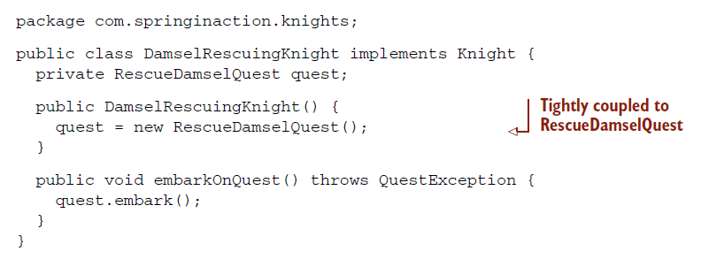
Example

Slide 28
Example
As you can see, DamselRescuingKnight creates its own quest, a RescueDamselQuest, within the constructor.
This makes a DamselRescuingKnight tightly coupled to a RescueDamselQuest and severely limits the knight’s quest-embarking repertoire.
If a damsel needs rescuing, this knight’s there.
But if a dragon needs slaying or a round table needs… well…rounding, then this knight’s going to have to sit it out.

Slide 29
Example
What’s more, it’d be terribly difficult to write a unit test for DamselRescuing-Knight.
In such a test, you’d like to be able to assert that the quest’s embark() method is called when the knight’s embarkOnQuest() is called.
But there’s no clear way to accomplish that here.
Unfortunately, DamselRescuingKnight will remain untested

Slide 30
Example
Coupling is a two-headed beast.
On one hand, tightly coupled code is difficult to test, difficult to reuse, difficult to understand, and typically exhibits “whack-a-mole” bug behavior (fixing one bug results in the creation of one or more new bugs).
On the other hand, a certain amount of coupling is necessary—completely uncoupled code doesn’t do anything.
In order to do anything useful, classes need to know about each other somehow.
Coupling is necessary, but should be carefully managed

Slide 31
Example
With DI, on the other hand, objects are given their dependencies at creation time by some third party that coordinates each object in the system.
Objects aren’t expected to create or obtain their dependencies—dependencies are injected into the objects that need them.
To illustrate this point, let’s look at BraveKnight in the following listing, a knight that’s not only brave, but is capable of embarking on any kind of quest that comes along.

Slide 32
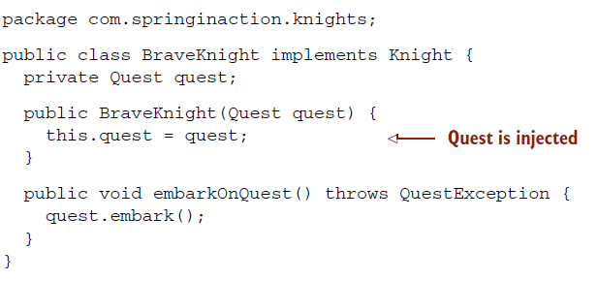
Example

Slide 33
Example
As you can see, unlike DamselRescuingKnight, BraveKnight doesn’t create his own quest.
Instead, he’s given a quest at construction time as a constructor argument.
This is a type of dependency injection known as constructor injection.
What’s more, the quest he’s given is typed as Quest, an interface that all quests implement.
So BraveKnight could embark on a RescueDamselQuest, a SlayDragon-Quest, a or any other Quest implementation he’s given.

Slide 34
Example
The point here is that BraveKnight isn’t coupled to any specific implementation of Quest.
It doesn’t matter to him what kind of quest he’s asked to embark upon, so long as it implements the Quest interface.
That’s the key benefit of DI—loose coupling.
If an object only knows about its dependencies by their interface (not by their implemen- tation or how they’re instantiated), then the dependency can be swapped out with a different implementation without the depending object knowing the difference.

Slide 35
Example
One of the most common ways that a dependency will be swapped out is with a mock implementation during testing.
You were unable to adequately test Damsel- RescuingKnight due to tight coupling, but you can easily test BraveKnight by giving it a mock implementation of Quest, as shown next.

Slide 36
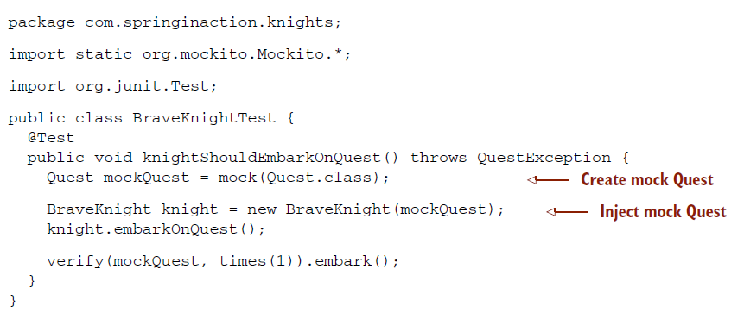
Example

Slide 37
Example
Now that your BraveKnight class is written in such a way that you can give him any quest you want, how can you specify which Quest to give him?
The act of creating associations between application components is commonly referred to as wiring.
In Spring, there are many ways to wire components together, but a common approach has always been via XML.
The following listing shows a simple Spring configuration file, knights.xml, that gives a BraveKnight a SlayDragonQuest.

Slide 38
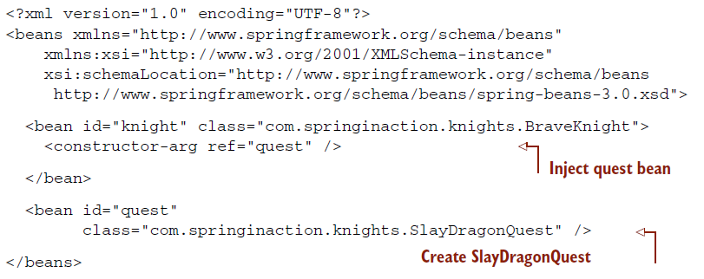
Example

Slide 39
Example
In a Spring application, an application context loads bean definitions and wires them together.
The Spring application context is fully responsible for the creation of and wiring of the objects that make up the application.
Spring comes with several implementations of its application context, each primarily differing only in how they load their configuration.

Slide 40
Example
Because the beans in knights.xml are declared in an XML file, an appropriate choice for application context might be ClassPathXmlApplicationContext.
This Spring context implementation loads the Spring context from one or more XML files located in the application’s classpath.
The main() method in the following listing uses ClassPathXmlApplicationContext to load knights.xml and to get a reference to the Knight object.

Slide 41
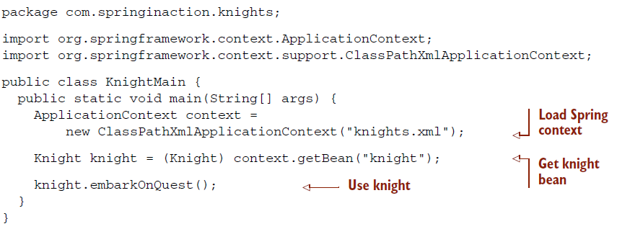
Example

Slide 42
Example
Here the main() method creates the Spring application context based on the knights.xml file.
Then it uses the application context as a factory to retrieve the bean whose ID is knight.
With a reference to the Knight object, it calls the embarkOnQuest() method to have the knight embark on the quest that it was given.
Note that this class knows nothing about which type of Quest our hero has.
For that matter, it’s blissfully unaware of the fact that it’s dealing with BraveKnight.
Only the knights.xml file knows for sure what the implementations are.

Slide 43
Aspect oriented programming
Let’s have a look at another of Spring’s Java-simplifying strategies: declarative programming through aspects
Aspect-oriented programming enables you to capture functionality that’s used throughout your application in reusable components

Slide 44
Aspect oriented programming
Often defined as a technique that promotes separation of concerns within a software system
Systems are composed of several components, each responsible for a specific piece of functionality
Often these components also carry additional responsibility beyond their core functionality, for example system services such as logging, transaction management, and security

Slide 45
Aspect oriented programming
By spreading these concerns across multiple components, you introduce two levels of complexity to your code
The code that implements the system-wide concerns is duplicated across multiple components. This means that if you need to change how those concerns work, you’ll need to visit multiple components
Your components are littered with code that isn’t aligned with their core functionality. A method to add an entry to an address book should only be concerned with how to add the address and not with whether it’s secure or transactional

Slide 46
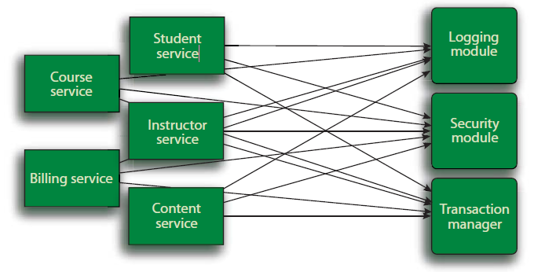
Aspect oriented programming
The business objects on the left are too intimately involved with the system services.
Not only does each object know that it’s being logged, secured, and involved in a transactional context, but also each object is responsible for performing those services for itself

Slide 47
Aspect oriented programming
AOP makes it possible to modularize these services and then apply them declaratively to the components that they should affect.
This results in components that are more cohesive and that focus on their own specific concerns, completely ignorant of any system services that may be involved.
In short, aspects ensure that POJOs remain plain

Slide 48
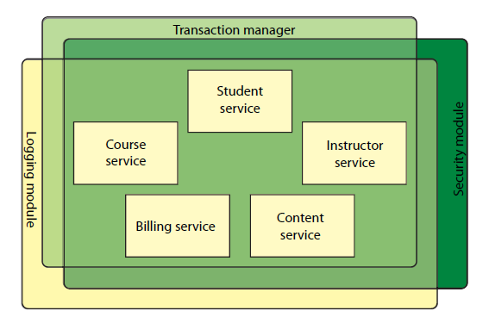
Aspect oriented programming
At its core, an application consists of modules that implement business functionality.
With AOP, you can then cover your core application with layers of functionality.
These layers can be applied declaratively throughout your application in a flexible manner

Slide 49
Aspect oriented programming
To demonstrate how aspects can be applied in Spring, let’s revisit the knight example, adding a basic Spring aspect
Anyone who knows anything about knights only knows about them because their deeds were chronicled in song by the musically inclined storytellers known as minstrels.
Let’s suppose that you want to record the comings and goings of your Brave-Knight using the services of a minstrel.
Let’s consider the simplest solution, as suggested in the following slides

Slide 50
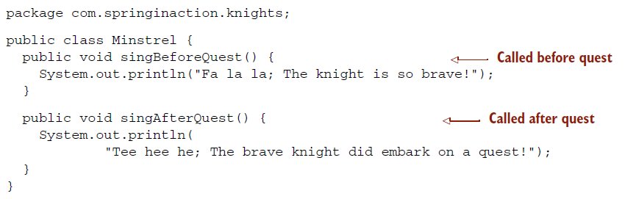
Aspect oriented programming

Slide 51
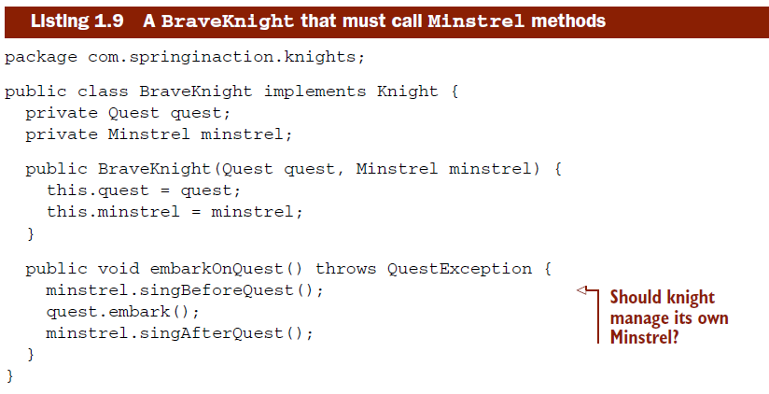
Aspect oriented programming

Slide 52
Aspect oriented programming
Any problem with previous solution?
Something doesn’t seem right there.
Is it really necessary that the knight has to manage his minstrel?
Minstrel should just do his job without the knight asking him to do so.
Why should the knight have to keep reminding the minstrel to do his job?

Slide 53
Aspect oriented programming
Furthermore, because the knight needs to know about the minstrel, you’re forced to inject the Minstrel into the BraveKnight.
This not only complicates the Brave-Knight’s code, but also brings a question – what if you’d ever want a knight who didn’t have a minstrel?
What if the Minstrel is null? Should we introduce some null-checking logic to cover that case?
Your simple BraveKnight class is starting to get more complicated

Slide 54
Aspect oriented programming
But using AOP, you can declare that the minstrel should sing about a knight’s quests and free the knight from having to deal with the Minstrel methods directly.
To turn Minstrel into an aspect, all you need to do is declare it as one in the Spring configuration file.
Here’s the updated knights.xml file, revised to declare Minstrel as an aspect.

Slide 55
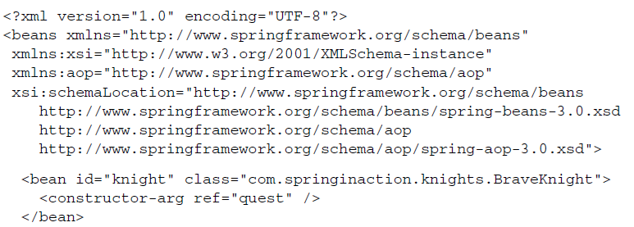
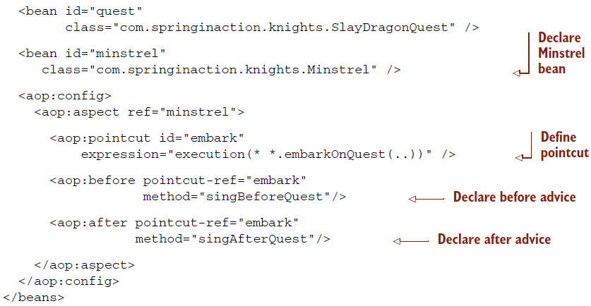
Aspect oriented programming

Slide 56
Aspect oriented programming
First, you had to declare the Minstrel as a bean. Then you refer to that bean in the <aop:aspect> element.
Defining the aspect further, you declare (using <aop:before>) that before the embarkOnQuest() method is executed, the Minstrel’s singBeforeQuest() should be called.
This is called before advice.
And you (using <aop:after>) declare that the singAfterQuest() method should be called after embarkOnQuest() has executed.
This is known as after advice. In both cases, the pointcut-ref attribute refers to a pointcut named embark.
This pointcut is defined in the preceding <pointcut> element with an expression attribute set to select where the advice should be applied.
The expression syntax is AspectJ’s pointcut expression language.

Slide 57
Aspect oriented programming
For now it’s enough to know that you’ve asked Spring to call the Minstrel’s singBeforeQuest() and singAfterQuest() methods before and after the BraveKnight embarks on a quest.
That’s all there is to it! With a tiny bit of XML, you’ve just turned Minstrel into a Spring aspect.
Don’t worry if this doesn’t make complete sense yet—you’ll see plenty more examples of Spring AOP later that should help clear this up.
For now, there are two important points to take away from this example.

Slide 58
Aspect oriented programming
First, Minstrel is still a POJO—nothing about it indicates that it’s to be used as an aspect.
Instead Minstrel became an aspect when we declared it as such in the Spring context.
Second, and most important, Minstrel can be applied to the BraveKnight without the BraveKnight needing to explicitly call on it.
In fact, BraveKnight remains completely unaware of the Minstrel’s existence.

Slide 59
Containing beans
In Spring application, your application objects will live within the Spring container
The container will create the objects, wire them together, configure them, and manage their complete lifecycle from cradle to grave (or new to finalize(), as the case may be)
First, it’s important to get to know the container where your objects will be hanging out.
Understanding the container helps you grasp how your objects will be managed.

Slide 60
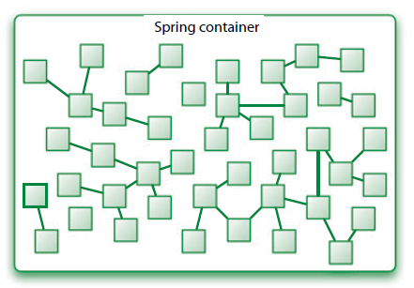
Containing beans
The container is at the core of the Spring Framework.
Spring’s container uses dependency injection (DI) to manage the components that make up an application.

Slide 61
Containing beans
Spring comes with several container implementations that can be categorized into two distinct types.
Bean factories (defined by the org.springframework.beans.factory.BeanFactory interface) are the simplest of containers, providing basic support for DI.
Application contexts (defined by the org.springframework.context.ApplicationContext interface) build on the notion of a bean factory by providing application framework services, such as the ability to resolve textual messages from a properties file and the ability to publish application events to interested event listeners

Slide 62
Containing beans
Although it’s possible to work with Spring using either bean factories or application contexts, bean factories are often too low-level for most applications.
Therefore, application contexts are preferred over bean factories.
We’ll focus on working with application contexts and not spend any more time talking about bean factories.

Slide 63
Containing beans
Spring comes with several types of application context.
The three that you’ll most likely encounter are:
  ClassPathXmlApplicationContext—Loads a context definition from an XML file located in the classpath, treating context definition files as classpath resources.
  FileSystemXmlApplicationContext—Loads a context definition from an XML file in the file system.
  XmlWebApplicationContext—Loads context definitions from an XML file contained within a web application.

Slide 64
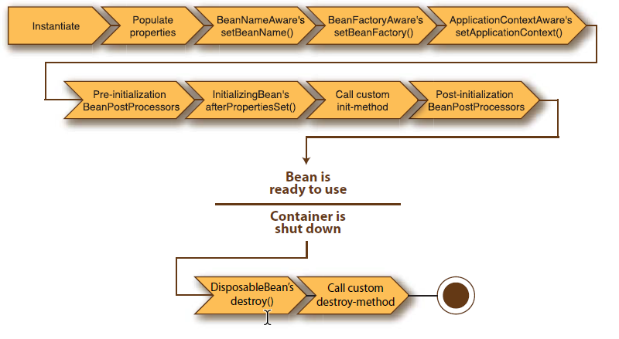
Containing beans
A beans life:

Slide 65
Containing beans
In a traditional Java application, the lifecycle of a bean is simple.
Java’s new keyword is used to instantiate the bean (or perhaps it’s deserialized) and it’s ready to use.
Once the bean is no longer in use, it’s eligible for garbage collection and eventually goes to the big bit bucket in the sky

Slide 66
Containing beans
The lifecycle of a bean within a Spring container:
Spring instantiates the bean.
Spring injects values and bean references into the bean’s properties.
If the bean implements BeanNameAware, Spring passes the bean’s ID to the setBeanName() method.
If the bean implements BeanFactoryAware, Spring calls the setBeanFactory() method, passing in the bean factory itself.

Slide 67
Containing beans
5 If the bean implements ApplicationContextAware, Spring will call the setApplicationContext() method, passing in a reference to the enclosing application context.
6 If any of the beans implement the BeanPostProcessor interface, Spring calls their postProcessBeforeInitialization() method.
7 If any beans implement the InitializingBean interface, Spring calls their afterPropertiesSet() method. Similarly, if the bean was declared with an init-method, then the specified initialization method will be called.
8 If there are any beans that implement BeanPostProcessor, Spring will call their postProcessAfterInitialization() method.
9 At this point, the bean is ready to be used by the application and will remain in the application context until the application context is destroyed.
10 If any beans implement the DisposableBean interface, then Spring will call their destroy() methods. Likewise, if any bean was declared with a destroy- method, then the specified method will be called.

